Slide 1
Credit EDA Case Study
By : Soukhya H S, Mukesh Rana

Slide 2
Introduction
This case study aims to identify patterns which indicate if a client has difficulty paying their installments
This will ensure that the consumers capable of repaying the loan are not rejected.
In other words, the company wants to understand the driving factors (or driver variables) behind loan default, i.e. the variables which are strong indicators of default.

Slide 3
Title and Content Layout with List
Univariate Analysis
A. Categorial Data
B. Continuous Data
Bivariate Analysis
A. Categorial Data
B. Continuous Data
Multivariate Analysis

Slide 4
1. Univariate Analysis

Slide 5
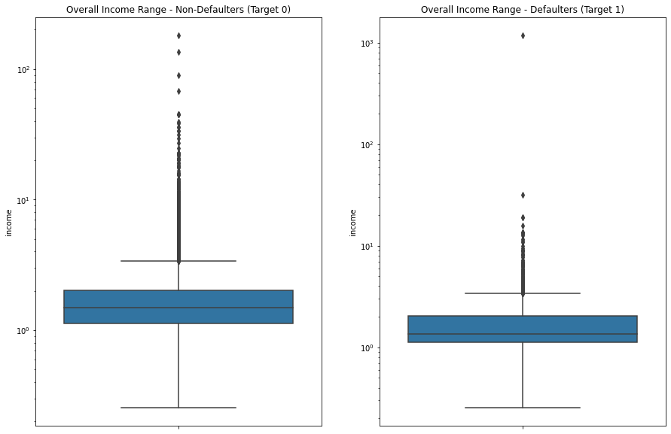
Univariate Analysis of Numerical Data (Income)
We can see that the income range for Non-Defaulter is wider than Defaulter applicants.
The average Income of Non-Defaulter is greater than Defaulter.
So in this case Its better to give the loan to Higher income holder.

Slide 6
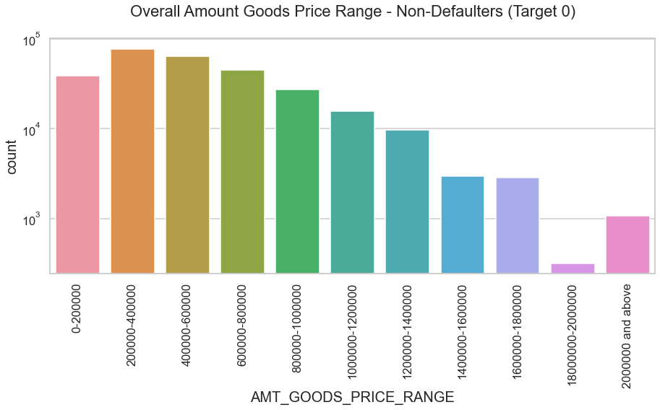
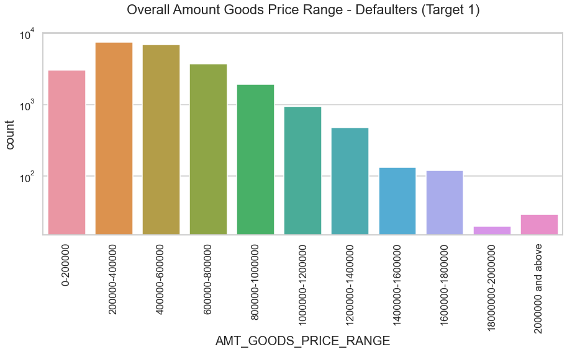
Univariate Analysis of Numerical Data (AMT_GOODS_PRICE_RANGE)
From these charts Its clear that applicants having more Goods amount are more inclined towards Non-Defaulter.
So it is safer to lend the loans to applicants owning more goods.

Slide 7
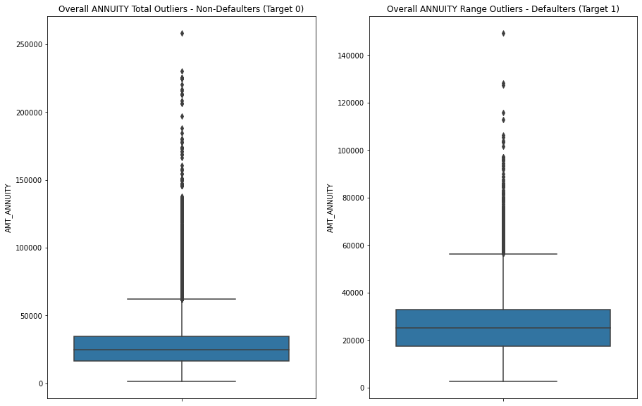
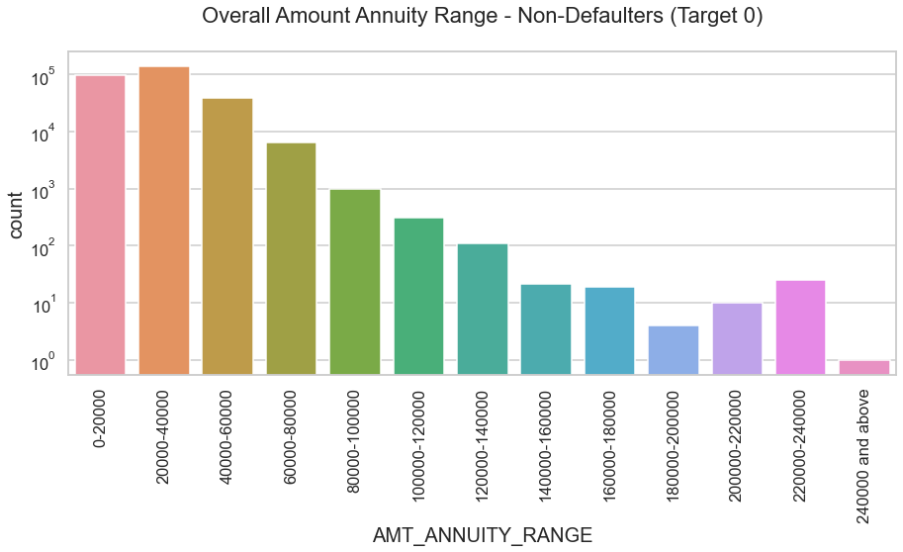
Univariate Analysis of Numerical Data (Annuity Amount)
It clearly showing that Non-Defaulters has less annuity amount.
Hence, if the annuity amount is higher then applicants faces difficulties in paying back.
So in this case Its better provide the loan at lesser or at the amount which applicants are capable to pay.
From 3er chart we can say that, It is safer to keep the annuity amount lesser than 80000.

Slide 8
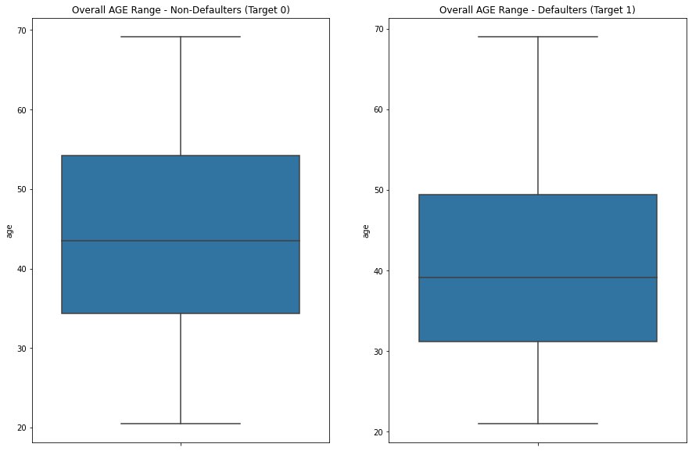
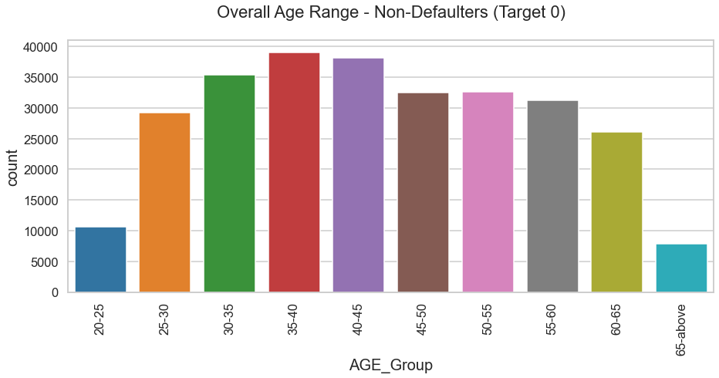
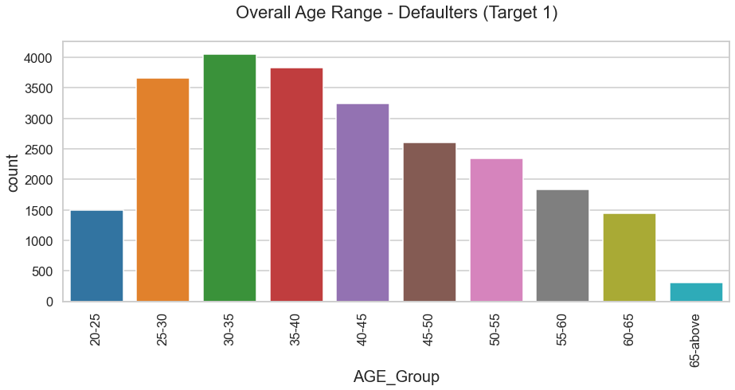
Univariate Analysis of Numerical Data (Age)
If we talk about average age of applicants, that Defaulters are younger than Non-Defaulter
The average age of Non-Defaulter is nearly 45 and for defaulter it is 39.
Most of the defaulters comes under 25-40 age group, whereas most of the Non-Defaulters comes under 30-45age group.
Here, It seem that it is safer to give loans to elders(more than 45 year old applicants) as they has less chances to be defaulter.

Slide 9
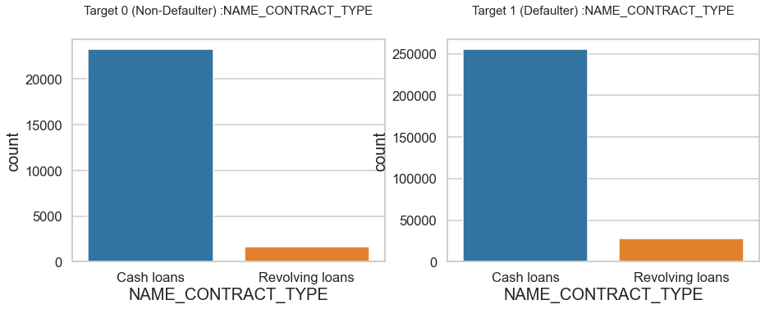
Univariate Analysis of Categorical Data (NAME_CONTRACT_TYPE)
We can see that there is minor difference between Defaulter and non-Defaulter taking cash and Revolving Loans.
Here we can say that Defaulter takes more loans for cash and Revolving both.
So here, because of minor difference we cannot say anything.

Slide 10
2. Bivariate Analysis

Slide 11
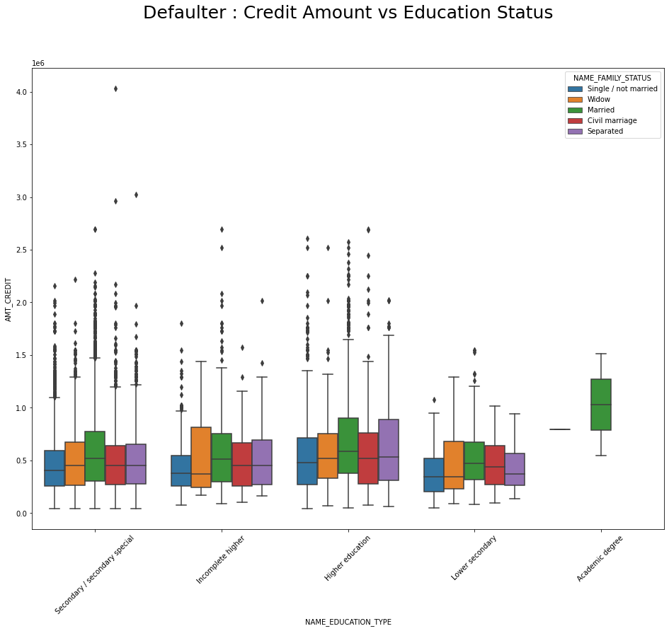
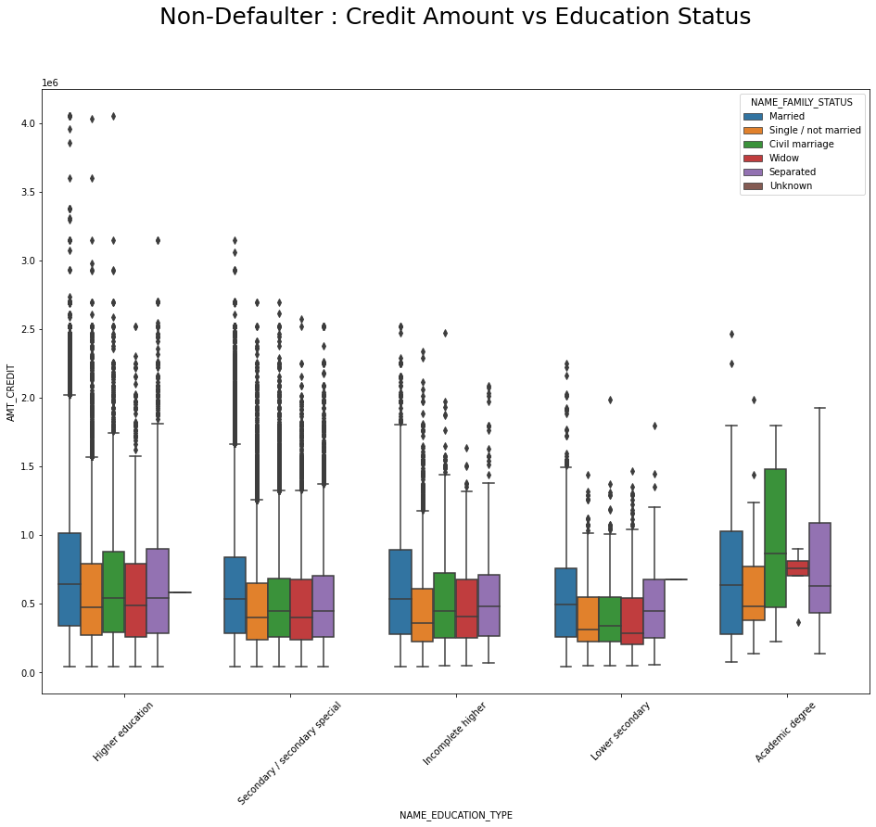
Bivariate Analysis of Categorical Data (NAME_EDUCATION_TYPE vs AMT_CREDIT)
For every level of education non-Defaulter has much spread-out in terms of credit.
At the same time Defaulter has narrower rang of credit.
It is safer to lend the money to Academic Degree holder as they are less tends to become Defaulter.

Slide 12
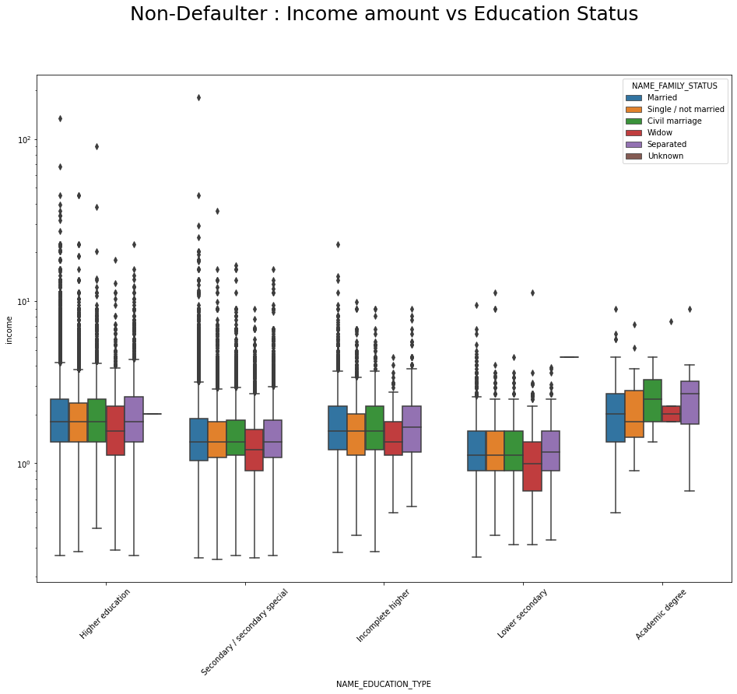
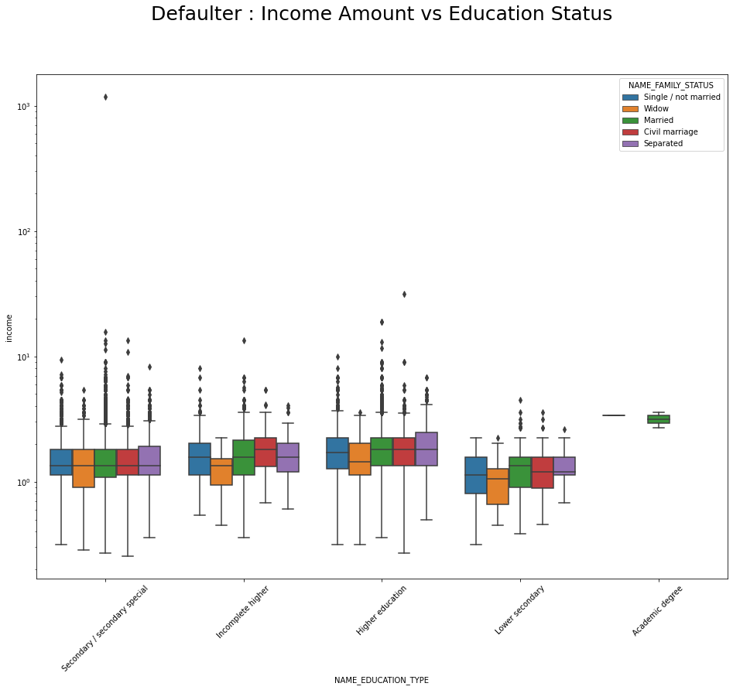
Bivariate Analysis of Categorical Data (NAME_EDUCATION_TYPE vs Income)
As we have already seen that it is safer to lend money to higher income holder.
Here, Highly Educated applicants has more spread of their income, hence they are safer applicants.
Almost all of the Academic Degree holder are Non-Defaulter.

Slide 13
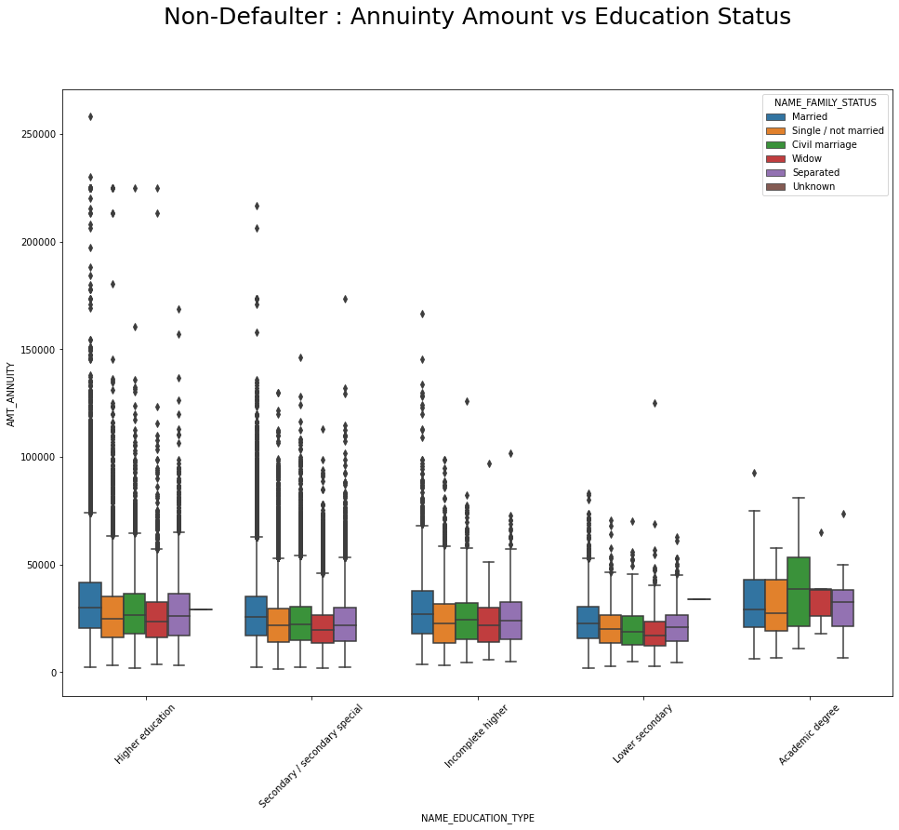
Bivariate Analysis of Categorical Data (NAME_EDUCATION_TYPE vs AMT_ANNUITY)
We have already seen that, lesser the annuity amount lesser chances of default.
Here, married applicants tends to have more annuity amount in all levels of education.

Slide 14
3. Multivariate Analysis

Slide 15
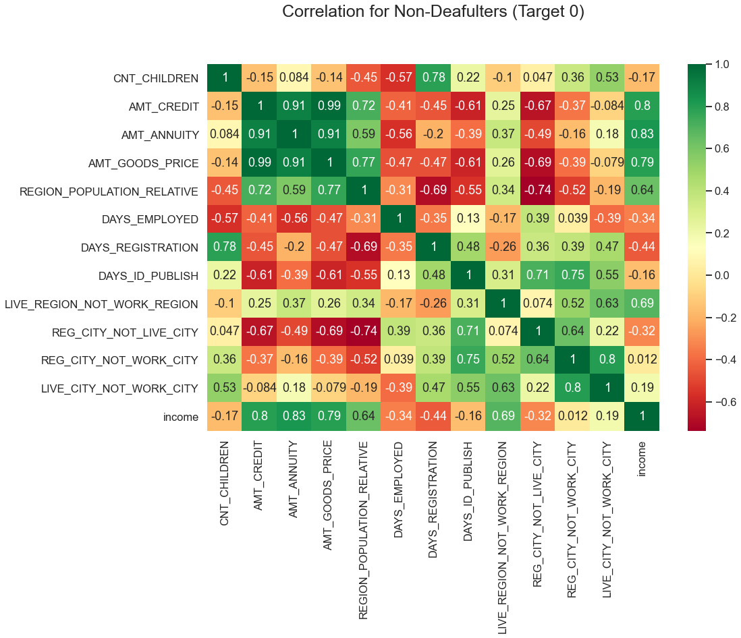
Multivariate Analysis (Correlation for Non-Defaulter)
Most of the variables has higher correlation coefficient.
For example annuity amount and credit amount are highly correlated.
Similarly for the applicants owning more goods has very high credit amounts and so on.

Slide 16
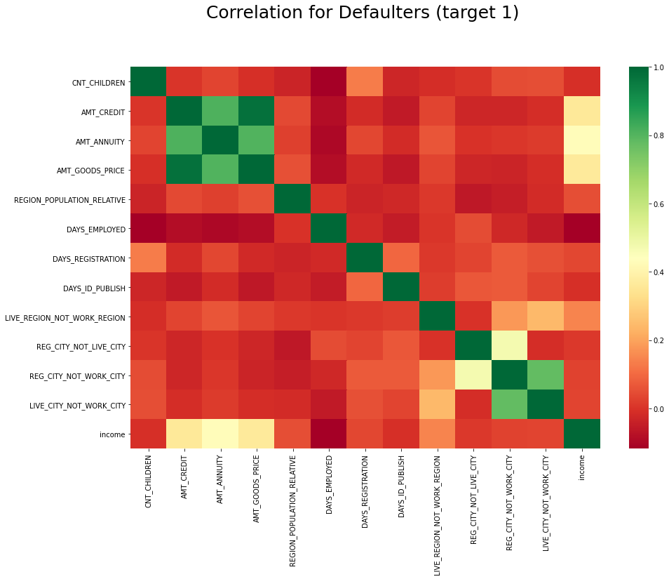
Multivariate Analysis (Correlation for Defaulter)
For Defaulters, Credit amount, annuity amount, Goods amount are highly correlated to each other.
Whereas most of the variable/factors has negative correlation coefficient.

Slide 17
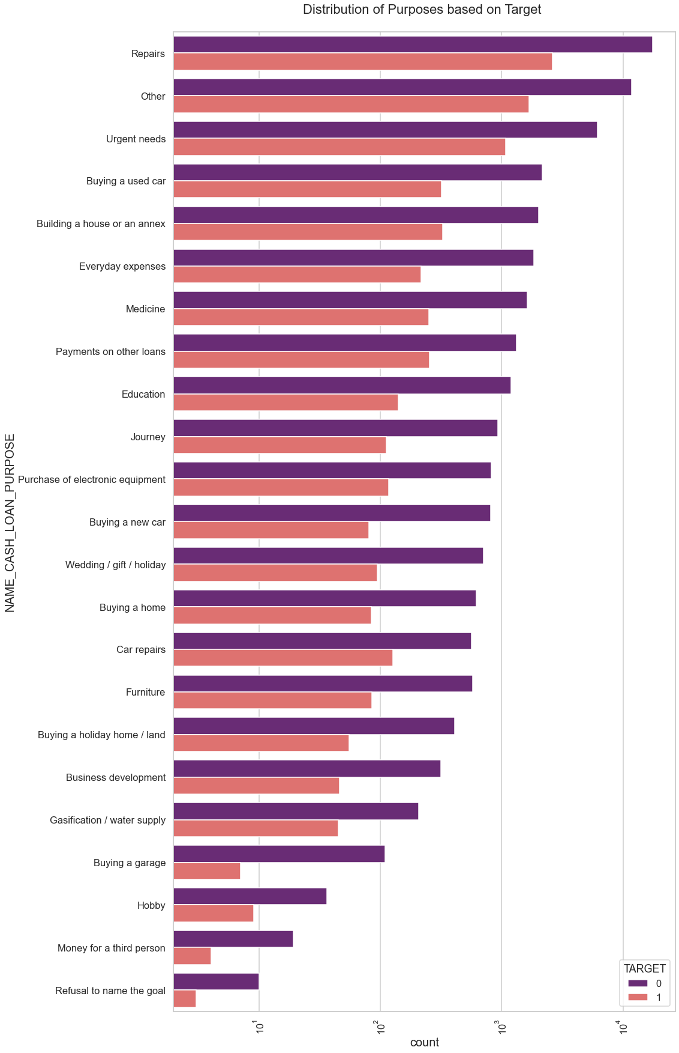
Multivariate Analysis (Purposes based on Target)
From this Non-Defaulter chart we can conclude that Repairs, Others, and Urgent need are very popular purpose of lending loans.
All purposes has chances of default as well as chances of non-default. But, chances of non-default is always more in all purposes.

Slide 18
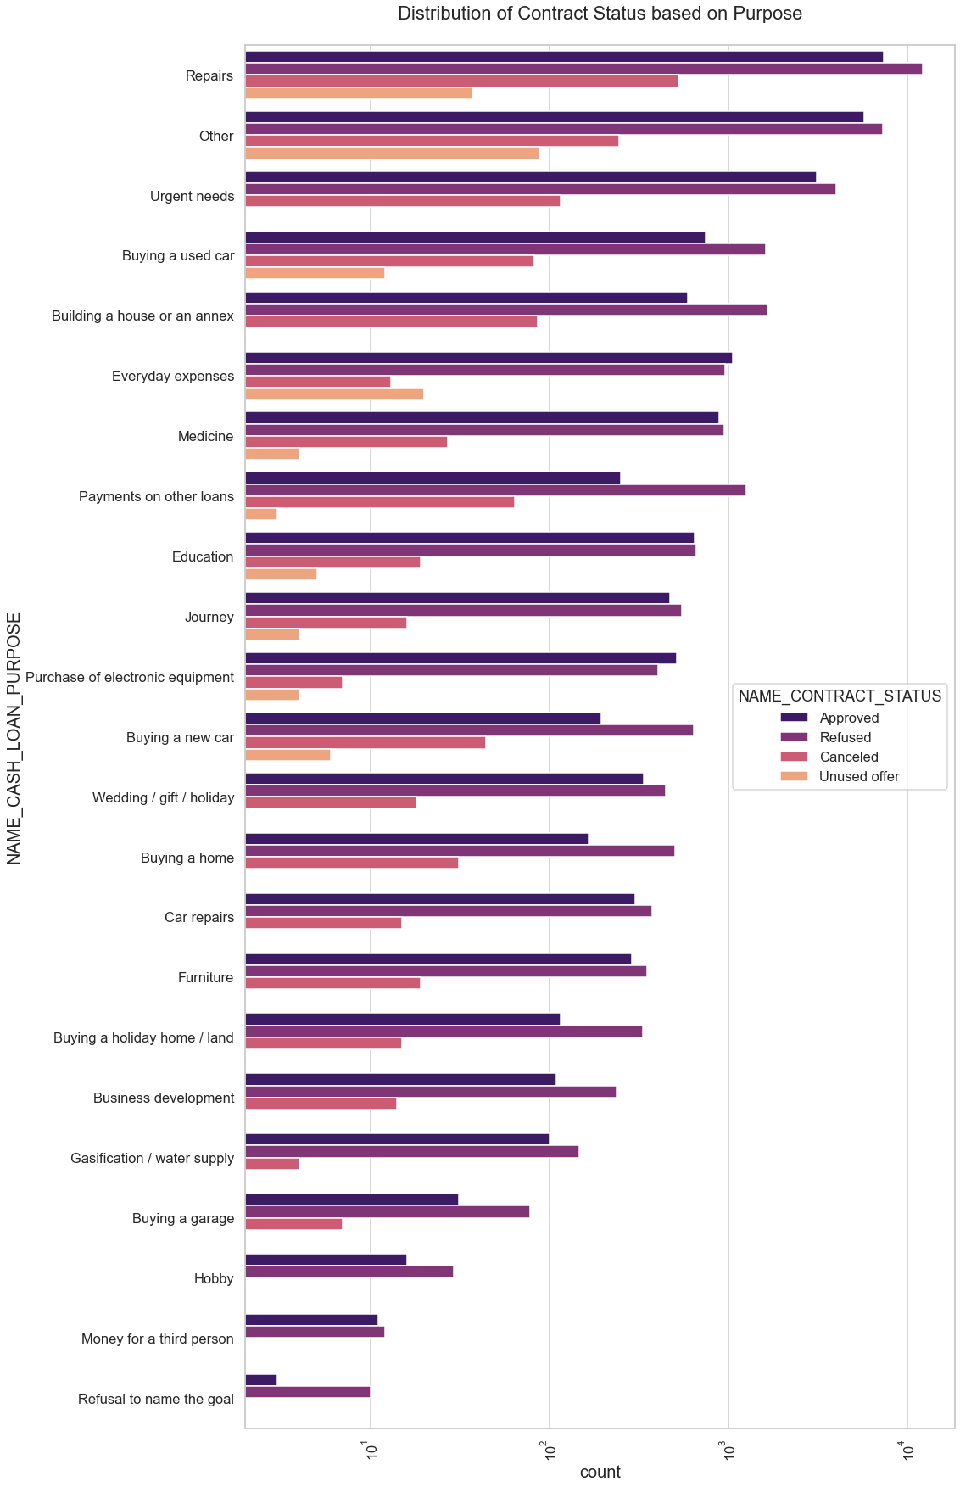
Multivariate Analysis (Contract Status based on Purpose)
This shows the loan status for different purpose.
Repairs, Others, Urgent needs are the purpose which are approved and rejected maximum time.
If the purpose is Purchasing electronic equipment then there is high chances of getting approved, otherwise all purposes has high chances of Rejection of application.

Slide 19
CONCLUSION
It is safe to give loan to Applicants who are holding "Higher Degree" or holding "Academic Degree".
Among "Academic Degree" holders people having Family status other then "Married" are the most safest category to give loan.
It is very unsafe to give loan to "Widow" Applicants who have studied only till "Lower Secondary".
Loan purposes with "Repairs" are facing more difficulties in payment on time.
Its not safe to give loans to people living in Co-op apartment.
It is safe to give loan to the people living with there parents as there is very less chance of Defaults.
Banks should focus more on contract type "Student" ,"pensioner" and "Businessman" with housing "type other than "Co-op apartment" for higher rate of successful payments.

Slide 20
Thank You

